Slide 1
hindi handwriting recognition project
project overview

Slide 2
pre-requisites
Knowledge on Deep network
Convolutional Neural networks
Basic intuition about tensorflow
Basics of keras
Image processing basics

Slide 3
creating a data model
We have created a data model using Devanagari dataset available.
Trained dataset have a accuracy of 95.09%
Which are going to refer for our original computation of the project.
As we are always going to compare the user input with the model that we have developed.

Slide 4
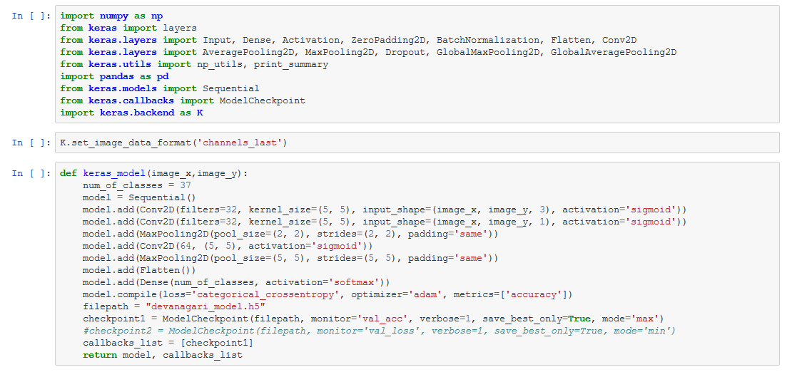
code for model

Slide 5
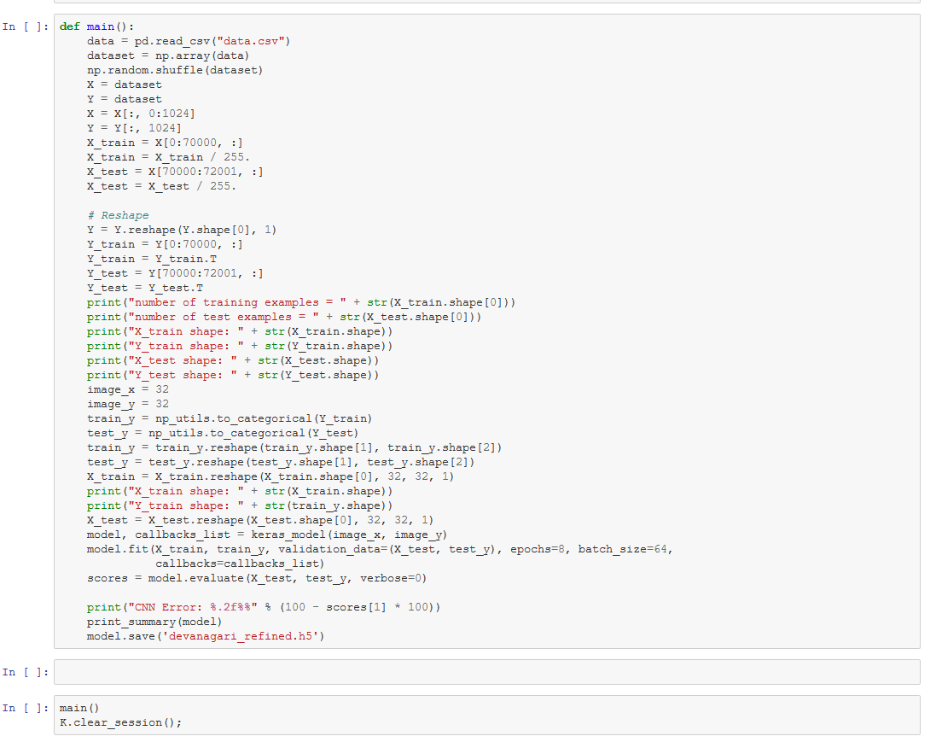

Slide 6
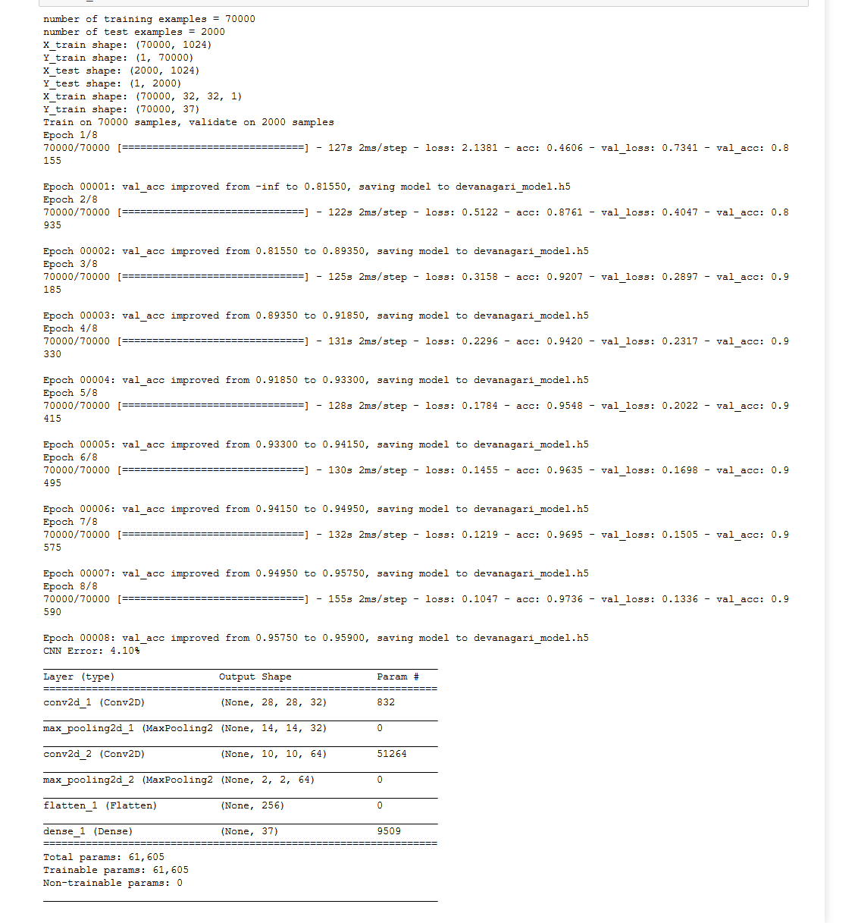
output of model

Slide 7
implementing the model
using the cv2 module of python we are going to convert the contour encircled by a blue dot to a recognisable hindi alphabet.
And then contour is being predicted to the closely resemblence of the alphabet with the trained data.
with Accuracy percentage of - 94.3%

Slide 8
conclusion
Machine learning is developing at a much faster rate as expected.
It is one of the critical parts of the Artificial Intellegnce.
Like hindi recognition tool we can also implement Digit recognition program.

